Slide 1
Information System Design
Project Planning
Information System Design

Slide 2
Project Planning Activities
The project planning activities include both business-level and technical-level planning.
Business-level planning addresses the relationships with the customer.
Includes the project and business objectives, proposal writing, analysis and inclusion of functional requirements, product demand and its scope, and legal issues.
Technical-level planning focuses on performing the technical activities.
concentrates on technical issues, such as selection of the development life cycle model, planning documentation methods and tools, risk management planning, estimations, financial planning, resource allocation and management, team structuring and organization, software development life cycle plan, documentation plan, configuration management plan, quality assurance plan, transition plan, and so on.

Slide 3
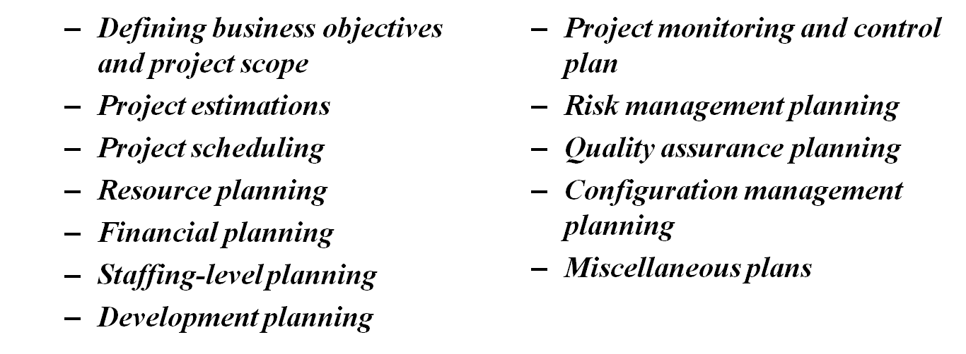
Project Planning Activities
A project plan includes various activities related to project management.
A general project plan includes the following project planning activities, beginning with project initiation to project completion.

Slide 4
Software Metrics and Measurements
Software metric is the unit of measurement of software product, project, and process attributes.
There are three types of metrics used in software projects:
  Product metrics,
  Process metrics,
  Project metrics.

Slide 5
Project Size Estimation
Size measurement is the initial step for estimating the other attributes of software.
It is a direct measurement, which is based on the problem size.
Programs written in any programming language have some size, whether the program is an assembly code, a high-level language code, a GUI code, or a component of a programming language.
There are various units of size measurement, such as
  Lines of code (LOC),
  Function point (FP),
  Token count (TC),
  Fuzzy logic sizing,
  Object point (OC),
  Standard component sizing, and many more.

Slide 6
Project Size Estimation
Lines of Code
  A line of code (LOC) metric is based on the measurement of the source lines of the code in a program.
  It is simply measured by counting the program header, declarations, executable, and non-executable lines in the source program.
  Comments lines, blank lines, and header lines are usually not considered during the LOC measurement.
  LOC is generally counted in kilo (thousand) line of codes (KLOC) per person-month (PM).

Slide 7
Size oriented metrics (LOC)
These metrics are derived by normalizing quality and/ or productivity measure by considering the size of the software that has been produced.
Using historical data or intuition, the planner estimates an optimistic (S_{opt}), most likely (S_{m}), and pessimistic (S_{pess}) values or counts for each information domain value
A three-point or expected-value can then be computed as a weighted of the three values
  S = (S_{opt}+4S_{m}+S_{pess})/6
Some size oriented measures are:
  Errors for KLOC -Defects of KLOC
  Dollar per KLOC -Pages of documentation per KLOC
  Errors/ person month -LOC per person month
Information System Design

Slide 8
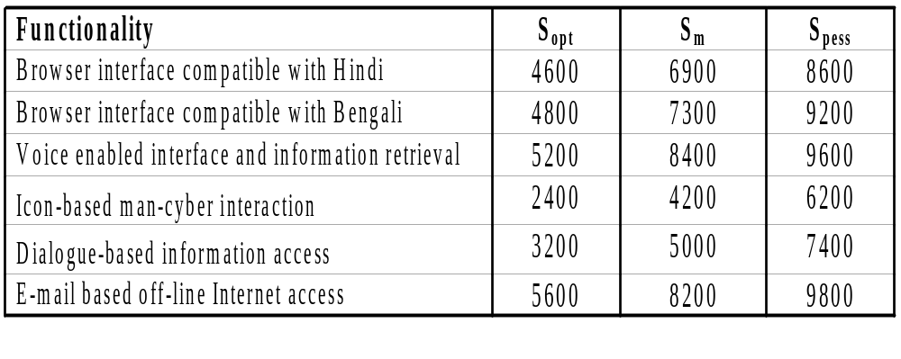
An Example of LOC Based Estimation
Let us consider the SANJOG project
Following values for LOC metrics have been evaluated
Information System Design

Slide 9
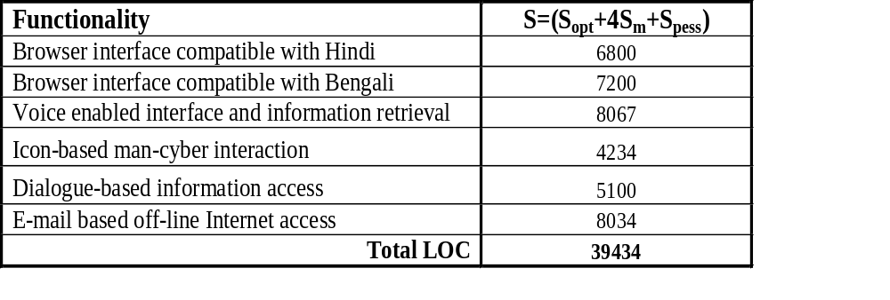
An Example of LOC Based Estimation
After the calculation of beta probabilistic values, the expected values can be calculated as shown
Information System Design

Slide 10
An Example of LOC Based Estimation
From the historical data assume the following
  A review of historical data indicates that the organizational average productivity for system of the project type is 420 LOC/PM
  Cost for a person-month, α = Rs. 20,000/
  Cost per line of code, β = Rs.50/
We can estimate
  Effort = LOC/α = 94 Person-months
  Cost = LOC *β = Rs. 19,71,700 ≈ Rs. 21 lakhs
Information System Design

Slide 11
Shortcomings of LOC
LOC measure gives a numerical value of problem size that can vary widely with individual coding style- different programmers lay out their code in different ways.
LOC focuses on the coding activity alone, i.e. it should consider total effort required to specify, design, code, test, etc.
LOC measure correlates poorly with the quality and efficiency of the code. A larger code size does not necessarily imply better quality. Some programmers produce lengthy and complicated code as they do not make effective use of the available instruction set.
LOC metric penalizes use of higher level of programming language, code reuse, etc. If a programmer uses library functions, then the LOC count will be lower.
LOC measures the lexical complexity of a program and does not address the more importantly logical complexities. Between two programs with equal LOC count, a program having complex logic would require much more effort to develop than a program with very simple logic.
It is very difficult to accurately estimate LOC in the final product from the problem specification.
Information System Design

Slide 12
Function oriented metrics (FP)
The idea behind FP metric is that the size of a software product is directly dependent on the number of different functions or features it supports.
They are derived using an empirical relationship based on countable measures of software’s information domain and assessment of complexity.
FP is computed based on 5 following information domain characteristics:
  Number of user inputs
  Number of user outputs
  Number of user inquiries
  Number of files
  Number of external interfaces
Information System Design

Slide 13
Project Size Estimation: FP-Based Metric
To compute function points (FP), the following empirical relationship is used
Here CountTotal is the sum of all FP entries
The F_{i} (i = 1 to 14) are value adjustment factor (VAF)
Information System Design

Slide 14
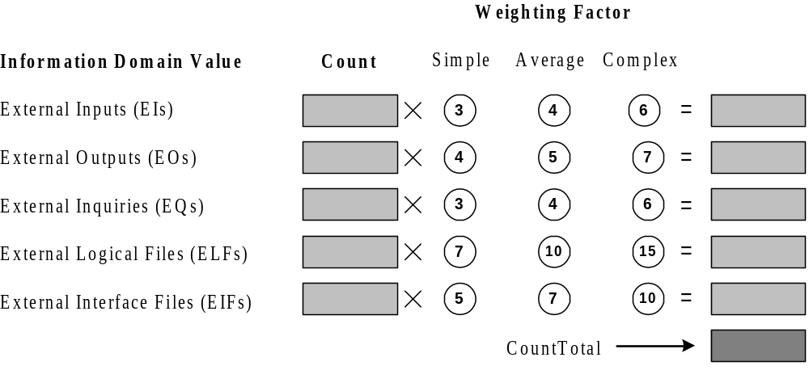
CountTotal in FP-Based Metric
Information System Design

Slide 15
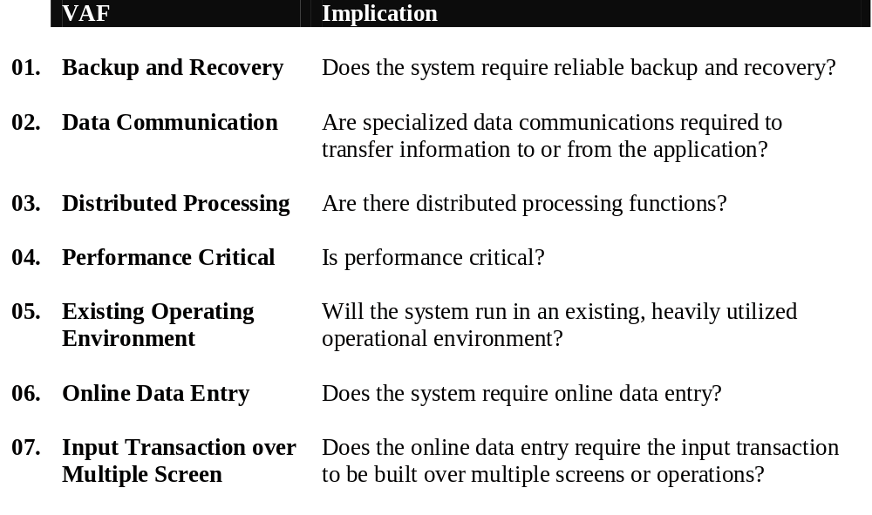
VAF in FP-Based Metric
Information System Design

Slide 16
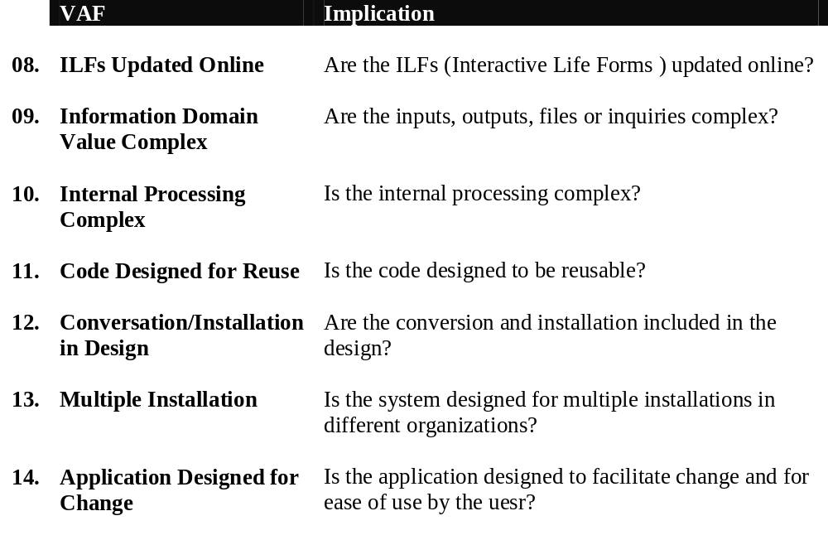
VAF in FP-Based Metric (Cont’d)
Information System Design

Slide 17
Values in FP-Based Metric
Each of the VAF is evaluated in scale of range from 0 (not important or applicable) to 5 (absolute essential)
The constant values in the equation for FP is decided empirically
The values for weighting factors that are applied to information domain counts are also determined empirically
Information System Design

Slide 18
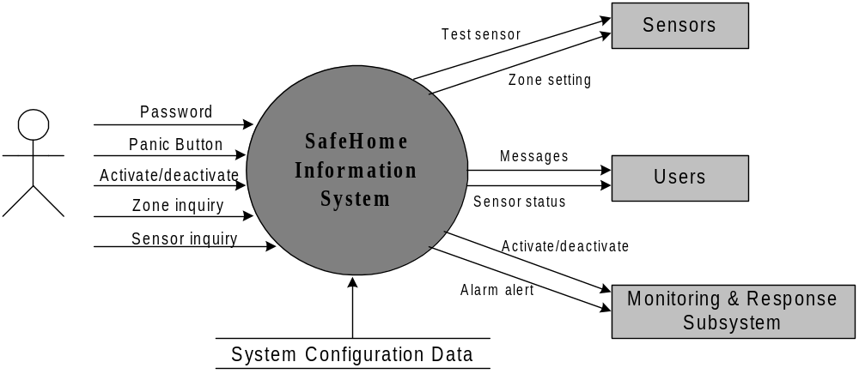
An Example of FP-Based Estimation
Information System Design

Slide 19
An Example of FP-Based Estimation
External inputs
Password
Panic Button
Activate/deactivate
External outputs
Messages
Sensor status
External inquiries
Zone inquiry
Sensor inquiry
Internal Logical file
System configuration file
External Interface Files
Test sensors
Zone setting
Activate/deactivate
Alarm alert
Information System Design

Slide 20
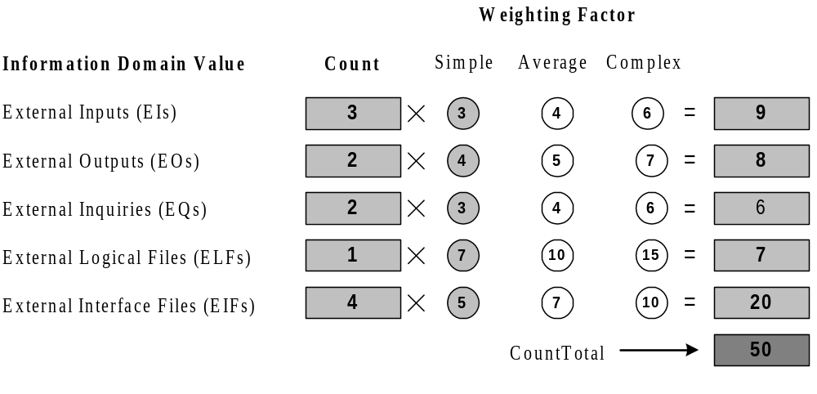
An Example of FP-Based Estimation
External inputs
Password
Panic Button
Activate/deactivate
External outputs
Messages
Sensor status
External inquiries
Zone inquiry
Sensor inquiry
Internal Logical file
System configuration file
External Interface Files
Test sensors
Zone setting
Activate/deactivate
Alarm alert
Information System Design

Slide 21
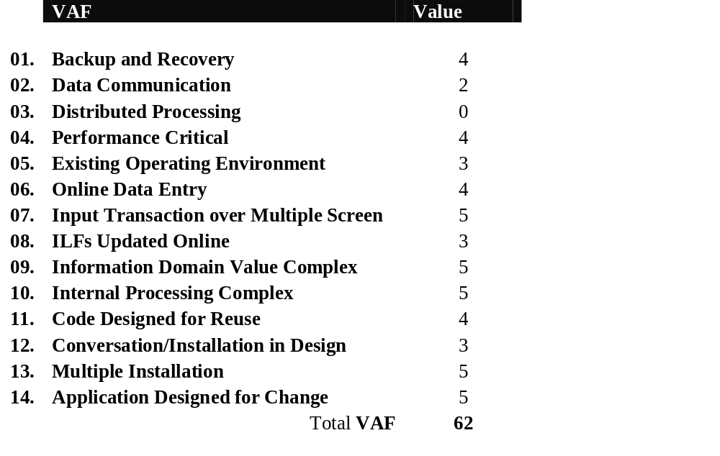
An Example of FP-Based Estimation
Information System Design

Slide 22
An Example of FP-Based Estimation
The estimated number of FP can be derived as
= 50 X [0.65 + 0.01 X 62]
= 63.5
Information System Design

Slide 23
Effort Estimation Techniques
Effort estimation predicts how much time is required to complete a project, how much it costs, and how many engineers are required for completing the project.
There are different techniques for effort estimation. Some of the most popular estimation techniques are
  Estimation by analogy,
  Delphi estimation,
  Algorithmic cost modelling, and
  Analytical techniques

Slide 24
Effort Estimation Techniques
Estimation by analogy
The estimation-by-analogy technique is based on the experiences of the past projects.
The estimation-by-analogy method involves an expert for finding the analogous situations so as to give his opinion.
This technique follows a top-down estimation approach.
The project to be assessed is characterized on certain factors that become the basis for finding similar or analogous projects which have been completed and their efforts are known.
Then the proposed project is compared with the previously completed similar projects.
These effort values are then used with some adjustments to estimate the efforts for the proposed project.

Slide 25
Effort Estimation Techniques
Delphi estimation
Delphi cost estimation is a group consensus technique that relies on expert judgment and follows the top-down estimation approach with certain features of the bottom-up approach.
The coordinator interacts with experts for providing necessary information and documents.
The estimators go through the requirement document and make their estimates anonymously.
The coordinator compiles the estimation reports and distributes a summary of the estimation responses.
The estimation report specifies any unusual characteristic noted by the estimators.
The coordinator can call a group meeting of experts to discuss points if the estimates vary widely.
The estimation is iterated for as many rounds as appropriate for an accurate estimate.

Slide 26
Effort Estimation Techniques
Algorithmic cost models
Algorithmic cost models use size estimation model, which is based upon certain project parameters.
The value of these parameters depends on the project type:
  Organic projects are very simple and can be developed with a small-size team. The team should have good application experience and should be familiar with the application environments. A simple data processing system is a good example of the organic category.
  Embedded projects are very complex and have stringent constraints, for example, flight control system for aircraft.
  Semidetached projects are intermediate in size and complexity. The team should have mixed experience to meet the mix of rigid and less-than-rigid requirements. A transaction processing system with fixed requirements for terminal hardware and database software is an example of the semi-detached category.

Slide 27
Effort Estimation Techniques
COCOMO Model
A single variable model is based only upon the size of the project, which is given as
Effort = a × Size ^{b}
The constants a and b are derived from the historical data of the past projects in the organizations.
The values of a and b in COCOMO model vary across the three categories of projects: organic, semidetached, and embedded, as shown in Table 4.2.
Project category | a | b
Organic | 3.2 | 1.05
Semidetached | 3.0 | 1.12
Embedded | 2.8 | 1.20
Table 4.2: The values of a and b constants

Slide 28
Effort Estimation Techniques
COCOMO Model
COCOMO estimation is a family of hierarchical models, which includes
  Basic,
  Intermediate, and
  Detailed COCOMO models.
Each of the models initially estimates efforts based on the total estimated KLOC.

Slide 29
Effort Estimation Techniques
Basic COCOMO Model
The basic COCOMO model estimates effort in a function of the estimated KLOC in the proposed project.
The basic COCOMO model is very simple, quick, and applicable to small to medium organic-type projects. It is given as follows:
Development effort (E) = a × (KLOC) ^{b}
Development time (T) = c × (E) ^{d}
Where a, b, c, and d are constants and these values are determined from the historical data of the past projects.
The development time (T) is calculated from the initial development effort (E).

Slide 30
Effort Estimation Techniques
Basic COCOMO Model
The values of c and d for organic-, semidetached-, and embedded-type projects are shown in Table 4.3.
Project category | c | d
Organic | 2.5 | 0.38
Semi-detached | 2.5 | 0.35
Embedded | 2.5 | 0.32
Table 4.3: The values of c and d constants

Slide 31
Basic COCOMO Model
Example 4.2
Assume that a system for simple student registration in a course is planned to be developed and its estimated size is approximately 10,000 lines of code. The organization is proposed to pay Rs. 25000 per month to software engineers. Compute the development effort, development time, and the total cost for product development.

Slide 32
Basic COCOMO Model
Solution 4.2:
The project can be considered an organic project. Thus, from the basic COCOMO model,
Development effort (E) = 3.2 × (10) ^{1.05} = 35.90 PM
Development time (T) = 2.5 × (35.90) ^{0.38} = 9.747 months
Total product development cost = Development time × Salaries of engineers
= 9.747 × 25000
= Rs. 2,43,675

Slide 33
Effort Estimation Techniques
Intermediate COCOMO Model
Boehm has introduced 15 cost drivers, considering the various aspects of product development environment.
These cost drivers are used to adjust the project complexity for estimation of effort and these are termed as effort adjustment factors (EAF).
These cost drivers are classified as computer attributes, product attributes, project attributes, and personnel attributes.
The intermediate COCOMO model computes software development effort as a function of the program size and a set of cost drivers.
The intermediate COCOMO model estimates the initial effort using the basic COCOMO model. Then the EAF is calculated as the product of 15 cost drivers.

Slide 34
Effort Estimation Techniques
Intermediate COCOMO Model
Total effort is determined by multiplying the initial effort with the total value of EAF. The computation steps are summarized below.
    Development effort (E):
      Initial effort (E_{i}) = a × (KLOC) ^{b}
      EAF= EAF₁ × EAF₂ ×... × EAF_{n}
      Total development effort (E)= E_{i} × EAF
    Development time (T) = c * (E) ^{d}

Slide 35
Intermediate COCOMO Model
Cost drivers
Cost drivers | Ratings
 | Very low | Low | Nominal |  | High |  | Very high |  | Extra high
Product attributes
Software reliability (RELY) | 0.75 | 0.88 | 1.00 | 1.15 |  | 1.40 |  | -
Size of database (DATA) | - | 0.94 | 1.00 | 1.08 |  | 1.16 |  | -
Product complexity (CPLX) | 0.70 | 0.85 | 1.00 | 1.15 |  | 1.30 |  | 1.65
Hardware attributes
Run-time performance constraints (TIME) | - | - | 1.00 | 1.11 |  | 1.30 |  | 1.66
Memory storage constraints (STORE) | - | - | 1.00 | 1.06 |  | 1.21 |  | 1.56
Virtual machine volatility (VIRT) | - | 0.87 | 1.00 | 1.15 |  | 1.30 |  | -
Required turnabout time (TURN) | - | 0.87 | 1.00 | 1.07 |  | 1.15 |  | -
Personnel attributes
Analyst capability (ACAP) | 1.46 | 1.19 | 1.00 | 0.86 |  | 0.71 |  | -
Applications experience (AEXP) | 1.29 | 1.13 | 1.00 | 0.91 |  | 0.82 |  | -
Programmer capability (PCAP) | 1.42 | 1.17 | 1.00 | 0.86 |  | 0.70 |  | -
Virtual machine experience (VEXP) | 1.21 | 1.10 | 1.00 | 0.90 |  | - |  | -
Programming language experience (LEXP) | 1.14 | 1.07 | 1.00 | 0.95 |  | - |  | -
Project attributes
Modern programming practices (MODP) | 1.24 | 1.10 | 1.00 | 0.91 |  | 0.82 |  | -
Use of software tools (TOOL) | 1.24 | 1.10 | 1.00 | 0.91 |  | 0.83 |  | -
Development schedule (SCHED) | 1.23 | 1.08 | 1.00 | 1.04 |  | 1.10 |  | -

Slide 36
Intermediate COCOMO Model
Example 4.3
Suppose a library management system (LMS) is to be designed for an academic institution. From the project proposal, the following five major components are identified:
Online data entry - 1.0 KLOC
Data update - 2.0 KLOC
File input and output - 1.5 KLOC
Library reports - 2.0 KLOC
Query and search - 0.5 KLOC
The database size and application experience are very important in this project. The use of the software tool and the main storage is highly considerable. The virtual machine experience and its volatility can be kept low. All other cost drivers have nominal requirements. Use the COCOMO model to estimate the development effort and the development time.

Slide 37
Intermediate COCOMO Model
Solution 4.3:
The LMS project can be considered an organic category project. The total size of the modules is 7 KLOC. The development effort and development time can be calculated as follows:
Development effort
Initial effort (E_{i}) = 3.2 × (7) ^{1.05} = 24.6889 PM
EAF = 1.16 × 0.82 × 0.91 × 1.06 × 1.10 × 0.87 = 0.8780
Total effort (E) = E_{i} * EAF
= 24.6889 × 0.8780
= 21.6785 PM
Development time (T) = 2.5 × (E) ^{0.38} month
= 2.5 (21.6785) ^{0.38} month
= 8.0469 month

Slide 38
Effort Estimation Techniques
Detailed COCOMO Model
The detailed COCOMO model inherits all the features of the intermediate COCOMO model for the overall estimation of the project cost.
The detailed COCOMO model uses different effort multipliers (cost drivers) for each phase of the project.
Phase-wise effort multipliers provide better estimates than the intermediate model.
The detailed COCOMO model defines five life cycle phases for effort distribution:
  plan and requirement,
  system design,
  detailed design,
  code and unit test, and
  integration and test.

Slide 39
Effort Estimation Techniques
Detailed COCOMO Model
In the detailed COCOMO model, effort is calculated as a function of size in terms of KLOC and the value of a set of cost drivers according to each phase of the software life cycle.
If the project size varies majorly from the value taken in the phase-wise distribution, then interpolation formula can be applied to find the more appropriate percentage value.
The detailed COCOMO model illustrates the importance of recognizing different levels of predictability at each phase of the development cycle.

Slide 40
Detailed COCOMO Model
Table 4.4: Phase-wise distribution of the development effort and time
Project type and size | Plan and requirement | System design | Detailed design | Code and unit test | Integration and test
Percentage-wise distribution of the development effort
Organic (2 KLOC) | 6 | 16 | 26 | 42 | 16
Organic (32 KLOC) | 6 | 16 | 24 | 38 | 22
Semi-detached (32 KLOC) | 7 | 17 | 25 | 33 | 25
Semi-detached (128 KLOC) | 7 | 17 | 24 | 31 | 28
Embedded (128 KLOC) | 8 | 18 | 25 | 26 | 31
Embedded (320 KLOC) | 8 | 18 | 24 | 24 | 34
Percentage-wise distribution of the development time
Organic (2 KLOC) | 10 | 19 | 24 | 39 | 18
Organic (32 KLOC) | 12 | 19 | 21 | 34 | 26
Semi-detached (32 KLOC) | 20 | 26 | 21 | 27 | 26
Semi-detached (128 KLOC) | 22 | 27 | 19 | 25 | 29
Embedded (128 KLOC) | 36 | 36 | 18 | 18 | 28
Embedded (320 KLOC) | 40 | 38 | 16 | 16 | 30

Slide 41
Detailed COCOMO Model
Example 4.4
Compute the phase-wise development effort for the problem discussed in Example 4.3.

Slide 42
Detailed COCOMO Model
Solution 4.4:
There are five components in the organic project discussed in Example 4.3: online data entry, data update, file input and output, library reports, query and search. The estimated effort (E) is 21.6785 PM. The total size is 7 KLOC, which is between 2 KLOC and 32 KLOC. Thus, the actual percentage of effort can be calculated as follows:
Plan and requirement (%) = 6 + (6 - 6) / (32 - 2) × 7 = 6%
Effort = 0.06 × 21.6785 PM = 1.30071 PM
System design = 16 + (16 - 16) / (32 - 2) × 7 = 16%
Effort = 0.16 × 21.6785 PM = 3.46856 PM
Detailed design = 24 + (26 - 24) / (32 - 2) × 7 = 25%
Effort = 0.25 × 21.6785 PM = 5.419625 PM
Code and unit test = 38 + (42 - 38) / (32 - 2) × 7 = 39%
Effort = 0.39 × 21.6785 PM = 8.454615 PM
Integration and test = 22 + (16 - 22) / (32 - 2) × 7 = 24%
= 0.24 × 21.6785 PM = 5.20284 PM

Slide 43
Effort Estimation Techniques
COCOMO I Model
The basic, intermediate, and detailed COCOMO models are in the category of COCOMO I and these are collectively known as COCOMO 81.
The COCOMO I models were developed to estimate the effort, schedule, and cost of a software project.
The three variations of COCOMO I use different types of parameters for estimation.
These models are helpful to produce repeatable estimations.
It is unable to deal with exceptional conditions, such as exceptional teamwork, exceptional people involved in the estimation process, etc.
Rough sizing of projects and inaccurate cost driver rating will result in an inaccurate estimation.

Slide 44
Effort Estimation Techniques
COCOMO II Model
COCOMO II is an extension to the original COCOMO 81 model.
Since the development of COCOMO 81, software development techniques have changed.
These changes have changed the development processes from linear to spiral and one-go to incremental way for developing simple to complex projects.
Programming techniques and technologies have moved from conventional to component-based software development.
Thus, a new, enhanced COCOMO II model was proposed to overcome the limitations of COCOMO 81.
It consists of sub-models, each one providing unique features for project planning and design process. These sub-models are called
  The applications composition model,
  Early design model,
  Post-architecture model, and
  Reuse model.

Slide 45
Effort Estimation Techniques
Application Composition Model
The application composition model is best suitable for prototyping projects and projects where there is extensive reuse of components.
It involves prototyping efforts to resolve unexpected risks related to GUI, device interaction, performance, or technology maturity.
The estimation is based on the standard estimates of the developer productivity in object points/months and the use of CASE tools to support development.
The effort estimation in an application is computed as follows:
  Effort (E) = (∑AP × (1 - %reuse/100))/ PROD
∑AP is the sum of application points in the system to be developed. PROD is the productivity of programmers from the historical data rated on some scale.
The PROD for the past projects is rated as very low = 4, low = 7, nominal = 13, high = 15, and very high = 50. Effort (E) will be measured in person-months (PM). %reuse is the percentage of reusable components that will be reused in the application.

Slide 46
Effort Estimation Techniques
Early Design Model
The early design model is used when requirements are available but design has not yet commenced.
It involves exploration of an alternative architecture or concept of operation. The estimation formula based on simple COCOMO is given as follows:
Effort (E) = A × Size ^{B} × EAF
A and B are constants. The value of A is fixed at 2.94 from a large data set.
The value of B varies with the project size and it can range from 1.1 to 1.24, depending on the project complexity, process maturity level, development flexibility, risk resolution processes, and cohesion of the development team in an organization.
EAF is the effort adjustment factor based on seven characteristics of projects and processes such as, product reliability and complexity (RCPX), reuse required (RUSE), platform difficulty (PDIF), personnel capability (PERS), personnel experience (PREX), schedule (SCED) and support facilities (FCIL).

Slide 47
Effort Estimation Techniques
Post-Architecture Model
This model is used once the system architecture has been designed and sufficient information is available for the development and maintenance of the system.
Estimation is determined using the estimation formula of early design model as follows:
Effort (E) = A × Size ^{B} × EAF
SLOC or FP can be used for determining the project size.
There are 17 instead of 7 multiplicative cost drivers.

Slide 48
Effort Estimation Techniques
Post-Architecture Model: Multiplicative cost drivers
Cost drivers | Attributes | Category
Required system reliability | RELY | Product
Product complexity | CPLX | Product
Required level of documentation | DOCU | Product
Database size | DATA | Product
Percentage of reusable components | RUSE | Product
Execution time constraint | TIME | Computer
Development platform volatility | PVOL | Computer
Memory constraints | STOR | Computer
Analysts capability | ACAP | Personnel
Personnel continuity | PCON | Personnel
Programmer capability | PCAP | Personnel
Programmer experience in application | PEXP | Personnel
Analyst experience in project domain | AEXP | Personnel
Language and tool experience | LTEX | Personnel
Use of software tools | TOOL | Project
Development schedule | SCED | Project
Multisite working | SITE | Project

Slide 49
Effort Estimation Techniques
Post-Architecture Model
The following five factors determine the project’s scaling exponent B. The value of these factors is added (for example, here it is 16) and their value in percentage (i.e. .16) is added to 1.01 to get a value of 1.17.
Precedentedness | --New project | --Rated low (4)
Development flexibility | --No client involvement | --Rated very high (1)
Architecture/risk resolution | --No risk analysis carried out | --Rated very low (5)
Team cohesion | --New team | --Rated nominal (3)
Process maturity | --Process in control | --Rated nominal (3)

Slide 50
Effort Estimation Techniques
Reuse Model
The reuse model focuses on system development with reuse.
It helps to monitor the progress of reuse-based development and guides to the investment for producing reusable assets and reusing them in development.
The cost of system development with reuse involves the cost incurred in design, implementation, generalization, testing, documentation, library support, and integration of reusable assents.
The level of reuse in a system is defined as the total size of the system divided by the size of the reusable components in the system.
The level of reuse can be used to monitor reuse and to estimate the cost, time, quality, and productivity.

Slide 51
Effort Estimation Techniques
Reuse Model
The cost of system development can be assessed by the cost of system development with reuse and without reuse.
The cost of software can be measured as:
    Total cost (C_{S}) = Cost of the reused software + Cost of the software without reuse
    = (Relative cost of the reused software × Reused software) + (Relative cost of the software without reuse × Software without reuse)
    = (C_{R} × R_{ѕ} ) + (C_{RW} × (1- R_{ѕ} ))
    = (C_{R} × R_{ѕ} )+ (1× (1- R_{ѕ} ))
    = 1+ R_{ѕ} (C_{R} - 1)

Slide 52
Effort Estimation Techniques
  Analytical techniques
  Halstead has proposed analytical estimation technique based upon certain assumptions about the project.
From the science of Halstead, the length and volume of code can be measured. The length of a code is used to measure the length of the source code program. It is defined as follows:
N = N1 + N2
Where N1 is the total number of operator occurrences, and N2 is the total number of operand occurrences.
The volume metric is used to measure the amount of storage space required for the program. It is defined as:
V = N log (n1 + n2)
Where n1 is the number of distinct operators, and n2 is the number of distinct operands that occur in a program.
Analytical estimation is manly useful for estimating software efforts in maintenance, scheduling, and reporting projects.

Slide 53
Staffing and Personnel Planning
Project managers fix the staff requirement early in the project because multiple projects may be running in the organization.
The number of staff varies at different times as the project progresses.
The staff requirement increases during the system design, detailed design, coding, and testing times.
The staff requirement decreases during integration, deployment and training, and documentation.
Norden in 1958 analysed several research and development projects and studied the staffing patterns in the software development cycle.
He observed that the staffing pattern can be approximated by the Rayleigh distribution curve as shown in Figure 4.2 and the Rayleigh curve can represented by the equation:
E = K/t²_{d} × t × e^{-t²}/2t²_{d}

Slide 54

Staffing and Personnel Planning
The Rayleigh curve represents the relationship between effort (E) and time (t_{d}) at any point of time.
E indicates the staffing requirement at any particular time during the duration of the project.
K is the total area under the curve, which represents the total effort requirements for the project. t_{d} is the time at which the curve reaches its maximum value.
E
E = K/t²_{d} × t × e^{-t²}/2t²_{d}
K
(Total effort area)
t_{d} Time
Figure 4.2: The Rayleigh curve

Slide 55
Staffing and Personnel Planning
In 1976, Putnam subsequently analysed various army projects using the Rayleigh curve for determining the personnel level of effort required in the software life cycle
Putnam found that t_{d} in Norden’s equation is the time when a project reaches the testing and integration and deployment stage.
After observing a large number of projects, Putnam derived the following expression for the personnel level effort pattern in any project:
S = C_{k} K^{1/3} t^{4/3}_{d}
Where S is the product size in KLOC and C_{k} represents the technological aspects that may affect productivity.
K is the total effort in person-month required yearly and t_{d} represents the time taken from project initiation to product deployment.

Slide 56
Project Scheduling and Milestones
Project scheduling activities
  Task identification
  Work breakdown structure
  Task interdependency
  Time allocation
  Resource allocation
  Monitoring, tracking, and control

Slide 57
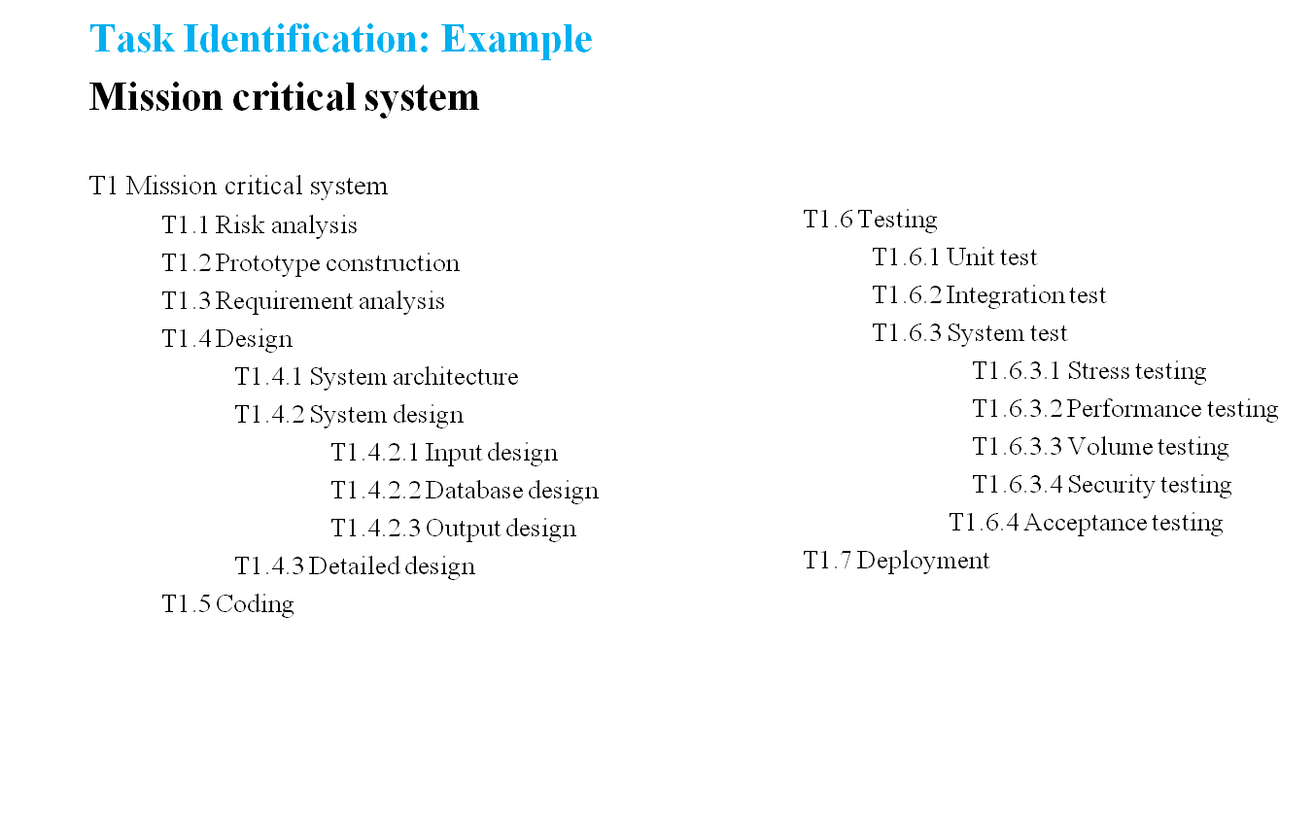
Project Scheduling and Milestones

Slide 58
Project Scheduling and Milestones
Work Breakdown Structure for Mission Critical System
Mission critical system
Risk
Prototype
Requirement
Design
Coding
Testing
Deployment
a
nalysis
construction
analysis
System
System
Detailed
Unit
System
Integration
Acceptance
architecture
design
design
testing
testing
testing
testing
Input
Output
D
atabase
Stress
Performance
Recovery
design
design
design
testing
testing
t
esting
Figure 4.4: Work breakdown structure

Slide 59
Project Scheduling and Milestones
Task interdependency
Task interdependency represents the dependency relationship or the sequence of tasks between a pair of activities.
WBS is converted into an activity network diagram (AND) that shows the task interdependency in the project.
The activity network diagram is designed using
  Project Evaluation and Review Technique (PERT)
  Critical Path Method (CPM).

Slide 60
Project Scheduling and Milestones
PERT-CPM Method
PERT is a network-based representation of tasks or activities to determine the task interdependency.
It represents the precedence or parallel relationships among the tasks in a project.
A PERT diagram has the following construction rules:
  Each task or activity is represented as a node in boxes.
  Arrow shows the dependencies between tasks or activities.
  There is a start node, which has only an outgoing arrow, and an end node, which has only incoming arrows.
  An arrow pointing to a node comes from its predecessor activity, which must be completed before a task can begin.

Slide 61
Project Scheduling and Milestones
  PERT-CPM Method
  Arrows pointing out of a task box go to its successor tasks, which cannot start until at least this task is complete.
  For example, T1 is the predecessor of T2 in the following diagram. T2 cannot start until T1 is completed.
Predecessor
Successor
T1
Time duration
T2
Task 1
Task 2

Slide 62
Project Scheduling and Milestones
Example: Activity network diagram
Input
design, 6
Output
design, 6
Start, 0
Architectural design, 10
Database
design, 13
Finish, 0
Detailed design, 18
Figure 4.5: Activity network diagram

Slide 63
Project Scheduling and Milestones
PERT-CPM Method
The duration of the project must be at least the length of the longest path.
Thus, the estimated project duration equals the length of the longest path through the project network.
This longest path is called the critical path.
For larger projects, it may be helpful to determine the following values for each activity:
  Earliest Start time (TES): It is the earliest time an activity may begin after allowing the preceding activities to finish. Earliest start time (TES) = max (TEF of immediate predecessors).
  Earliest Finish time (TEF): It is the earliest time an activity may finish after allowing the preceding activities to finish. Earliest finish time (TEF) = TES + Activity duration.
  T_{ES} and T_{EF} are calculated in the forward pass through the network diagram.

Slide 64
Project Scheduling and Milestones
PERT-CPM Method
Sometimes activities take longer than the expected time duration that may delay project completion.
So, to determine how much late an activity can start or finish without delaying project completion as:
  Latest Start time (T_{LS}): It is the latest time an activity may begin without delaying project completion. Latest start time (T_{LS}) = T_{LF} - Activity duration.
  Latest Finish time (T_{LF}): It is the latest time an activity may finish without delaying project completion. Latest finish time = T_{LF} = min (T_{LS} of immediate successors).
  Slack time (TS): The slack time for an activity is the difference between its latest finish time and its earliest finish time. Slack time (TS) = TLF – TEF = TLS – TES.
  The backward pass through the network diagram is made starting with the final activities and moving backward in time toward the initial activities to calculate TLS and TLF.

Slide 65
Project Scheduling and Milestones
PERT-CPM Method
T_{ES} = 10
T_{EF} = 16
Input
design, 6
T_{ES} = 23
T_{EF} = 29
T_{LS} = 17
T_{LF} = 23
Output
design, 6
T_{ES}= 0
T_{EF}= 0
T_{ES} = 0
T_{EF} = 0
T_{ES} = 0
T_{EF} = 10
T_{ES} = 10
T_{EF} = 23
T_{ES} = 29
T_{EF} = 29
Start, 0
Architectural design, 10
Database
design, 13
T_{LS} = 23
T_{LF} = 29
Finish, 0
T_{LS} = 0
T_{LF} = 0
T_{LS} = 0
T_{LF} = 10
T_{LS} = 29
T_{LF} = 29
T_{LS} = 10
T_{LF}= 23
T_{ES} = 10
T_{EF}= 28
Detailed design, 18
T_{LS} = 11
T_{LF} = 29
Figure 4.6: PERT with the critical path

Slide 66
Project Scheduling and Milestones
Time allocation
The project time can be estimated based on certain assumptions and the experience of estimating the likely estimates of the activities in the project.
Therefore, the estimation of time duration for a project includes three time estimates:
  Optimistic time (T_{O}): It is the shortest time in which the activity can be completed.
  Most likely time (T_{M}): It is the completion time having the highest probability.
  Pessimistic time (T_{P}): It is the longest time that an activity might require.

Slide 67
Project Scheduling and Milestones
Time allocation
The expected time for each activity can be approximated using the following weighted average:
  Expected time (T) = (T_{O} + 4 × T_{M} + T_{P})/6
This expected time might be displayed on the network diagram along with the activities in boxes.
The variance for each activity is determined as:
  [(T_{P} - T_{O})/6]²
The variance in the total project durations is the sum of the variances of the activity duration on the critical path.
This is helpful for project managers in determining the completion time of the project.

Slide 68
Project Scheduling and Milestones
Resource allocation
A Gantt chart is a horizontal bar chart that provides a graphical illustration of a project schedule.
It is commonly used for scheduling the tasks, allocating the resources, and tracking the progress of projects.
Drawing a Gantt chart requires tasks, duration of the tasks, and resources requirements to complete the tasks. Gantt charts are also useful for monitoring the progress of the project.
In a Gantt chart, activities are generally shown vertically on the left-hand side and the horizontal bar indicates the start date, end date, and duration of each activity.

Slide 69
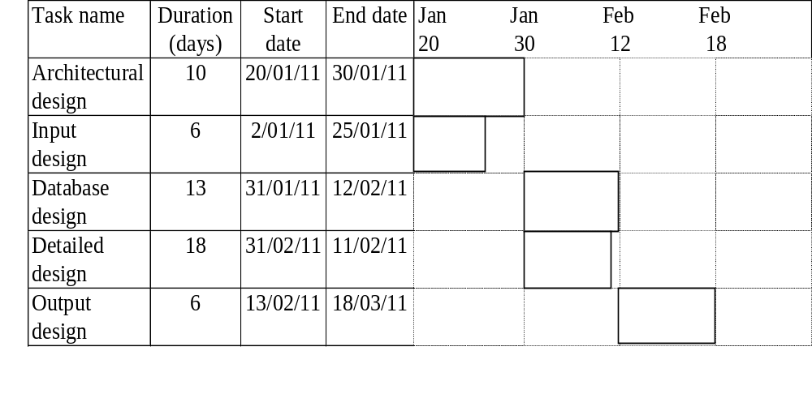
Project Scheduling and Milestones
Resource allocation
Figure 4.7: Gantt chart for software design

Slide 70
Project Scheduling and Milestones
Monitoring, Tracking, and Control
There are several methods for monitoring, tracking, and controlling the project activities.
Some automated tools such as Microsoft Project, SMART, etc., are also used for monitoring the projects.
The most popular methods used for project monitoring and tracking are
  Review meetings,
  Cost-schedule milestone graphs,
  Status reporting,
  Earn value methods, and so on.

Slide 71
Risk Management
Software risk management is necessary for the following reasons:
  To reduce the rework caused by missing, erroneous, or ambiguous requirements, design, or code, which typically consumes 40–50% of the total cost of software development
  To avoid software project disasters, including overrun of budgets and schedules, defect-ridden software products, and operational failures
  To stimulate a win-win software solution where the customer receives the product they need and the vendor makes the profits they expect.
  To keep provision for the detection and prevention mechanisms of risks.

Slide 72
Risk Categories
Risks basically threaten the project, product, and hence the business.
There are basically three categories of risk occurrence:
  Project Risks
  Products Risks
  Business Risks

Slide 73
Risk Management Activities
Some risks have great effect and some risks may be tolerated.
Risks must be analyzed to find their potential and remedial actions.
The risk management process includes the following activities:
  Risk Identification
  Risk Analysis
  Risk Planning
  Risk Monitoring and Control

Slide 74
Risk Management Activities
Risk identification
Risk analysis and evaluation
Risk planning
Risk monitoring
and control
Potential risks
Risk influences
Risk resolution plan
Risk assessment
Figure 3.11: Risk Management Process

Slide 75
Software Configuration Management
Software configuration management is concerned with identification, tracking, and change of control of software configuration.
Software configuration management (SCM) or configuration management (CM) is the discipline of identifying the configuration of a system at any time for the purpose of systematically controlling changes to the configuration throughout the system life cycle.
The purpose of CM is to establish and maintain the integrity of a software product throughout software the development life cycle.
The CM process improves product visibility, product protection, product control, customer confidence, and team communication.
A systematic CM process reduces rework, confusions, and project risks

Slide 76
Software Configuration Management
The project management process provides a systematic CM plan and monitors the status of the SCM process.
The configuration management officer (CMO) implements and maintains the CM process according to the CM plan.
The CMO coordinates, supports, and performs the CM activities and reports to the project manager.
The Configuration Control Board (CCB) approves and disapproves the changes to be performed in the product.
The CCB consists of technical and administrative representatives for configuration planning and execution.
The approved changes are performed through the development process.

Slide 77
Software Configuration Management
Configuration management process
Planning data
Project management process
CM plan
Status reports and audits results
Work products,
change requests
Approved change requests, controlled work products
Product development process

Slide 78
Software Configuration Management
The CM process consists of the following four activities
  Configuration identification
  Configuration change control
  Configuration status accounting
  Configuration auditing
Configuration identification
Configuration change control
Configuration status accounting
Configuration audits

Slide 79
Configuration Identification
A software configuration item (SCI) or configuration item (CI) is a work product that is designated for configuration management.
The SCI activity identifies items to be controlled, establishes identification schemes for the items and their versions, and establishes the tools and techniques to be used in acquiring and managing controlled items.
The work products in SCI may include plans, process descriptions, requirements, design data and models, product specifications, source codes, compilers, product data files, etc.
The status of the CIs at a given point in time is called baseline.
Each new baseline is the sum total of an older baseline plus a series of approved changes done on the CI.
A baseline together with all approved changes to the baseline represents the current configuration.

Slide 80
Configuration Change Control
The purpose of software configuration change control (CC) is to manage changes during the software life cycle.
The activities of CC are to identify what changes to make, the authority for approving changes, and support for the implementation of those changes.
The outcome of CC is useful in measuring change traffic, breakage, and aspects of rework.
A change request (CR) for changes to software configuration items may be originated by anyone at any point in the software life cycle and may include a suggested solution and requested priority.
The CRs are usually recorded on the software change request (SCR) form.
Once an SCR is received, a technical evaluation is performed to determine the extent of modifications that would be necessary should the change request be accepted.
An established authority, Configuration Control Board (CCB), will evaluate the technical and managerial aspects of the change request and accept, modify, reject, or defer the proposed change.

Slide 81
Configuration Status Accounting
The software configuration status accounting records and reports the information needed for effective management of the software configuration.
It is the bookkeeping process of each release for CIs.
The CI are identified, collected, and maintained for the status accounting.
The reported information can be used by the development team, the maintenance team and for project management and quality assurance activities.
A database is maintained for providing the status accounting of configuration requests.
This procedure involves tracking what is in each version of software and the changes that lead to this version.
It keeps a record of all the changes made to the previous baseline to reach the new baseline.

Slide 82
Configuration Auditing
Configuration auditing determines the extent to which an item satisfies the required functionalities.
Configuration audit is performed to evaluate the conformance of software products and processes to applicable regulations, standards, guidelines, plans, and procedures.
Auditing is performed according to a well-defined process consisting of various auditor roles and responsibilities.
Expertise of people is required and some automated tools also support the planning and conduct of an audit process.

Slide 83
Web-Based Tools for Estimation
http://csse.usc.edu/csse/research/COCOMOII/cocomo_papers.htm
https://www.pointingpoker.com/

